Slide 1
.1
Actions in partnership and communication tools through the BI Regio Communicators
Network
Liviu Rancioaga

Slide 2
Ensuring communication and continuity

Slide 3
THE STRATEGIC OBJECTIVE OF THE BI REGIO COMMUNICATORS NETWORK
To ensure the prompt and correct information of network members on topics related to REGIO and other financing opportunities, funds and European projects

Slide 4
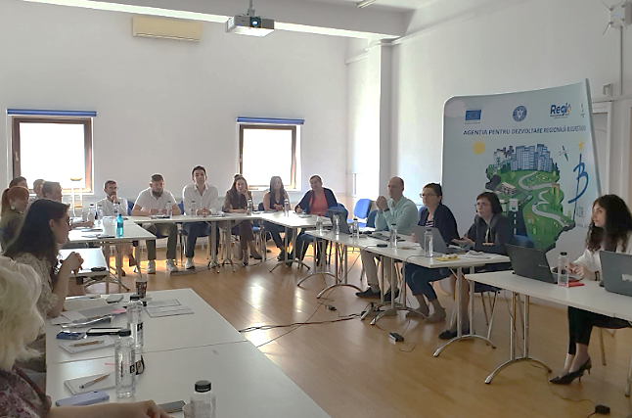
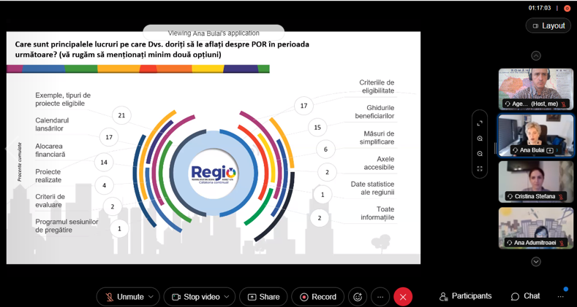
Supported actions
Organization of events in partnership (promotion, information, lessons learned, exchange of best practices, caravans)
Dissemination of official information
Supporting other initiatives of the European institutions

Slide 5
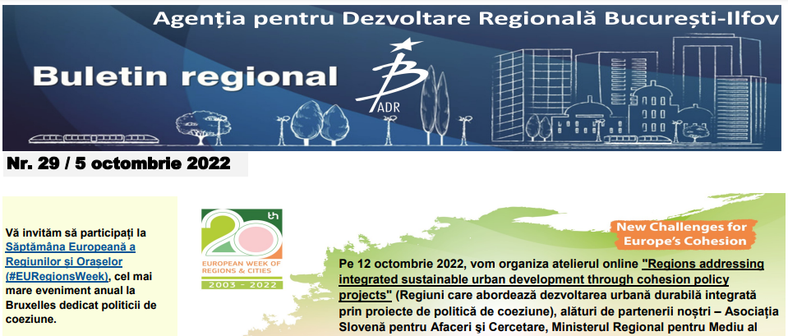
Methods of work
Exchange of personalized information via e-mail, website and social networks
Transmission of the Regional Bulletin /Newsletter
Questionnaires
Working meetings
Participation in events of mutual interest

Slide 6
Communication of BI RP 2021-2027
Multiannual communication plan
Website constantly updated
permanent sections (program description, consultation/open calls, allocations, eligibility, Program status, list of contracts, etc.),
Connecting with the unique national portal
Direct information
Facebook page, YouTube
Informative and promotional materials
Informative events

Slide 7
Reaching the target group
General public – RBI population
Specialized audience – potential beneficiaries/beneficiaries of PR BI operations: public administration; CDI organizations; universities; clusters; SMEs; chambers of commerce; NGOs etc.
Information facilitators – European and national networks, the internal public (MA RP and ADR BI employees, CDR BI, CRP BI, CRI BI, etc.); mass media; regional, national and international partners.

Slide 8
Discover Bucharest-Ilfov, the region for citizens - 11Stand22368
#EURegionsWeek 2022 / Exhibitors

Slide 9
Thank you!
Bucharest-Ilfov Regional Development Agency
163 Mihai Eminescu street, 2nd sector, Bucharest
Phone /Fax: +40 21.315.96.59; +40 21.315.96.65
E-mail: contact@adrbi.ro
www.adrbi.ro

